Slide 1
Big Data Project
Fish Project
Siel Farage and Noy Oved

Slide 2
Aquaculture What is aquaculture and what is it used for?
Aquaculture is often presented as a substitute for supplying fish for food and for the massive fishing solution that harms the fish population

Slide 3
Project Goals
Examine whether an increase in the volume of production in aquaculture is accompanied by a decrease in the volume of the fishing fleet and fishing quantity (tones)?
Is this change likely to increase or decrease the number of employed in this agriculture industry

Slide 4
The Feathers
Number of inland fish
Coastline length
Year
Country

Slide 5
The Target Functions:
Number of vessels
Number of employees
The number of fish from fishing

Slide 6
Work Process Description
First, we dropped countries that did not coincide in all our data tables
Handling null values
Features Normalization
We performed a correlation between the features and the target function
Applying Linear regression
And finally, we drew conclusions

Slide 7
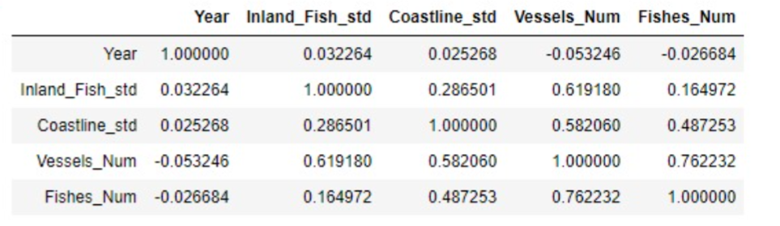
Number of vessels and fishing catch The Correlation:

Slide 8
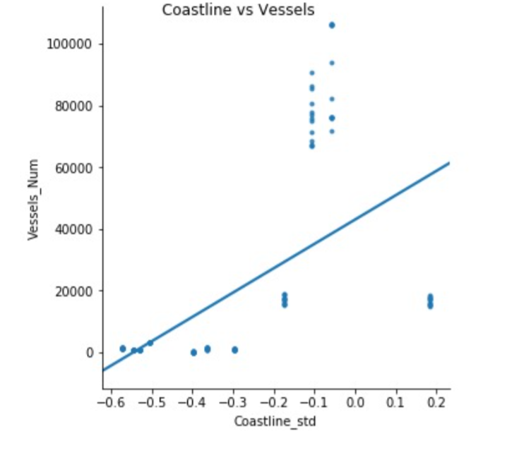
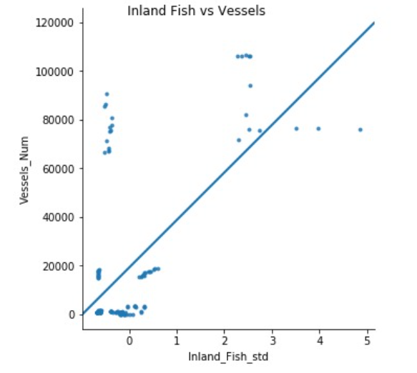
R-squared: 0.55394

Slide 9
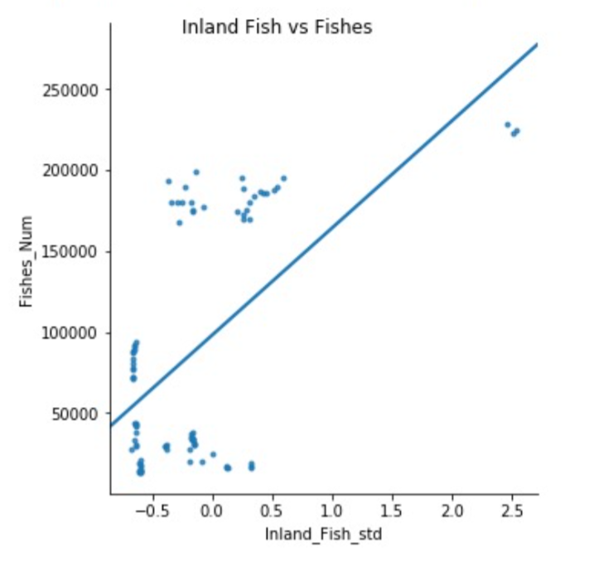
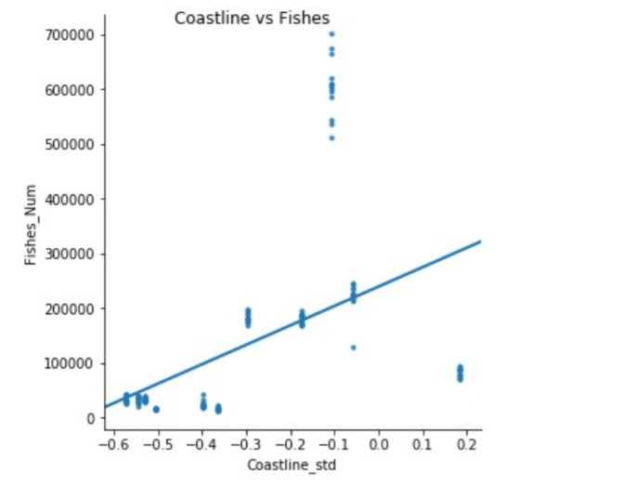
R-squared: 0.21026

Slide 10
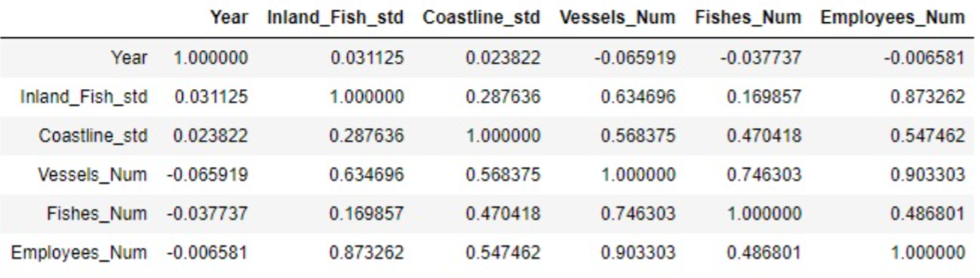
Marine Coastal Fishing The Correlation:

Slide 11
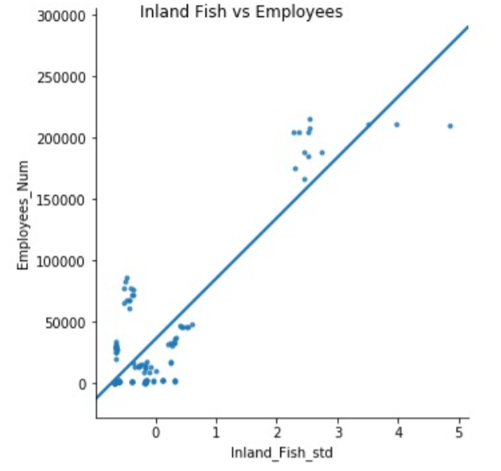
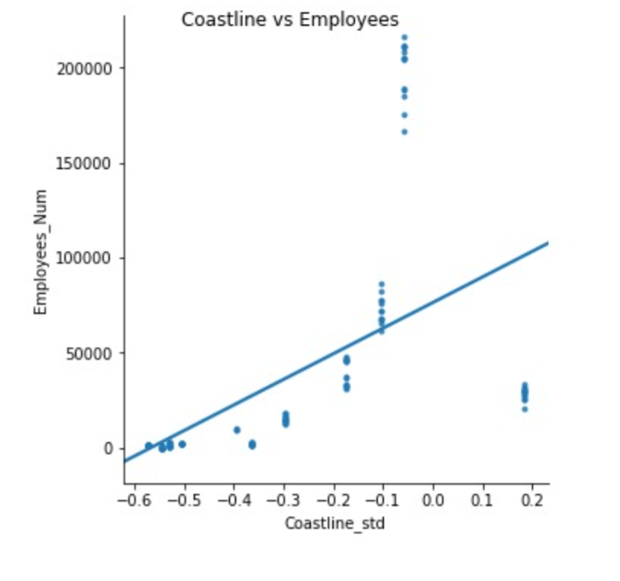
R-squared: 0.85794

Slide 12
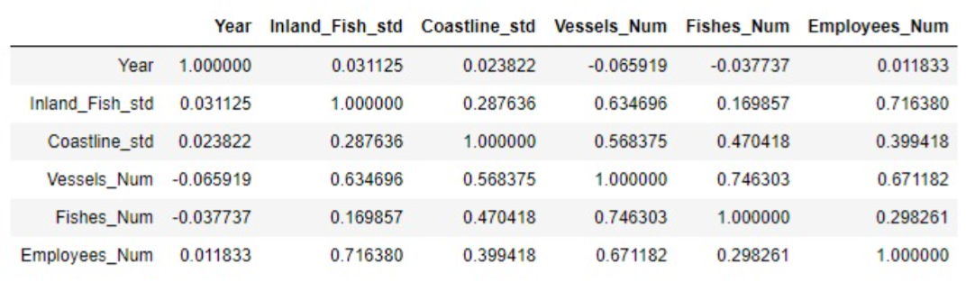
Fishing Sector The Correlation:

Slide 13
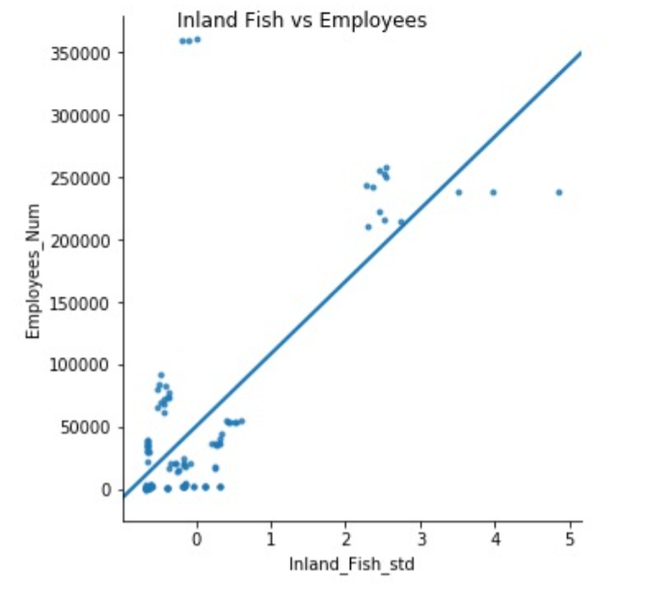
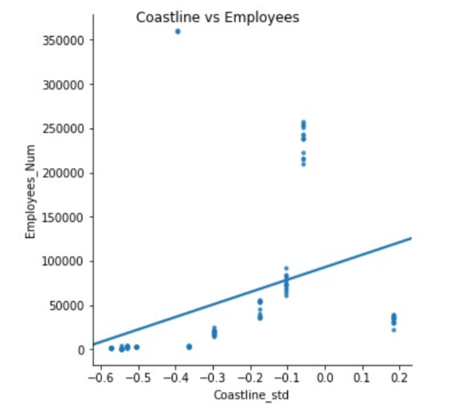
R-squared: 0.55374

Slide 14
The Conclusions
There are three different populations that affect the graph (e.g., Australia and Indonesia in the coastal area)
There is a relation between inland fish and the number of employed in the aquaculture industry.
There is a relation between the coastal area and the number of fish in the same coastal area.

Slide 15
Did you know?
The Irish government has decided to ban the continued cultivation of fish on aquaculture, after it became clear their severe harm to the wild fish population, which has caused economic damage on a national scale.
In Chile, damage was caused to a similar extent. A calculation made there showed that for the purpose of preparing food dumplings for fish on aquaculture, wild fish were extracted from the sea in much larger quantities than those raised in cages.

